Slide 1
FHIR for Developers
HL7 Working Group Meeting
Baltimore, US September 2016
David Hay

Slide 2
This presentation
Can be downloaded here:
http://gforge.hl7.org/svn/fhir/trunk/presentations/2017-01 Tutorials/
Use “anonymous” and email address to logon
Is licensed for use under the Creative Commons, specifically:
Creative Commons Attribution 3.0 Unported License
(Do with it as you wish, so long as you give credit)

Slide 3
Introduction
Notes:
Time start-10:00 (10 minutes)

Slide 4

Who am I?
Name: Jean Duteau
Company: Duteau Design
Background:
Involved in FHIR almost from beginning
Co-Chair Modelling & Methodology
Member: Technical Services Committee

Slide 5
Introductions
Who are:
Developers, Clinicians, Managers, Academics
Who is familiar with:
v2, v3, CDA
Who has been to the other tutorials
Who went to Connectathon
Who has a good basic understanding of FHIR

Slide 6
Level Setting
Should be familiar with basics of FHIR – from Introduction to FHIR or equivalent presentation or experience
This presentation will drill a little deeper into FHIR resources, REST, profiling, messaging, documents, XML and JSON syntax, etc.
Will get through as much as we can . . .

Slide 7
Tutorial Objectives
You should:
Know how to approach the FHIR specification to find out what more you need to know
Be able to start to build a FHIR client/server
Be able to explain what FHIR is to others in your organization, and what impact it might have
Be able to engage with the community
Notes:
9:15

Slide 8
Contents of this tutorial
Background
Resources
FHIR RESTful service interface
Resources in code
Bundles, Search
Beyond REST
Profiling
Beyond FHIR
Exposing FHIR
Notes:
[RS] This modified to match the actual section (also note here that the brochure Sept 2014 is wrong)
(RS – actual sections below. TODO update this slide.)
Introduction
Deconstructing FHIR
REST Interface
Resources in code
Break
Bundles
Search
Beyond REST
Inside the FHIR distro
Profiles and validation
Building a FHIR server
The End… is near

Slide 9
DSTU/STU?
It’s a release/publication status
Draft Standard For Trial Use – relabelled STU
Current version is STU2
This presentation is based on STU2
Next version (unfinished) is STU3
Ballot soon
Publication TBD
So will this be all changed by STU3
Not really… (Maturity model)

Slide 10
FHIR TIMELINE
First Draft
1st
DSTU
~ 2nd
STU
~ 3rd
STU
~ 1st
Norm.
~ 2nd
Norm.
. . .
Fresh
Look
2011
2012
2013
2014
2015
2016
2017
2018
2019
2020

Slide 11
Reviewing the spec
Versions (of the spec)
Main sections
Resource
REST
Operations
Implementation Guides

Slide 12
Development resources
Public test servers
Varying capability
HAPI CLI
(http://jamesagnew.github.io/hapi-fhir/doc_cli.html)
Invaluable to experiment
Manual Interaction, Validate, Operation
Tools
Modern web browser
REST client
XML/Json editor
Libraries
Java / .net / others
API
Validation

Slide 13
clinFHIR
An educational tool
View resource instances
Build resource
View Profile
Build simple profile
Build simple valueset
clinFHIR.com

Slide 14
The community
http://www.fhir.org/
https://chat.fhir.org/
http://community.fhir.org/
fhir@lists.hl7.org
http://wiki.hl7.org/index.php?title=FHIR
http://wiki.hl7.org/index.php?title=FHIR_gForge_Tracker
Notes:
Put a query out in real time…

Slide 15
Elevator speech
FHIR is:
About clinical information exchange
“Resources” to represent clinical ‘things’
A well defined API supporting all paradigms
An incredible – international - community
Spreading like <insert pun here>

Slide 16
Paradigms, API
REST
Documents
Messages
Operations Services
Content
Resources
Exchange
FHIR supports 4 interoperability paradigms

Slide 17
Architectures
v3
App
v2
FHIR
PHR
FHIR
Broker
Comm.
Interface
FHIR
DB
Notes:
You’re a message broker routing and translating between v2, v3 and FHIR
Your app interfaces with a PHR using FHIR natively
Your application can communicate using FHIR, but your software uses a proprietary RDBMS
[Use FHIR as the common language for a Vendor Neutral Archive – this is not pictured here but is ] [RS]
…Or a combination….
You might see data as a nested structure of XML, a series of tables with keys, class-diagrams….

Slide 18
Repository model
HIS
LIMS
PACS
SystemX
Gateway
FHIR
FHIR
FHIR
FHIR
FHIR
Vendor Neutral Repository

Slide 19
FHIR resources
Notes:
Time: 10:00-40:00 (30 minutes) [33 slides, 8 to 40]

Slide 20


Resources
“Resources” are:
Small logically discrete units of exchange
Defined behaviour and meaning
Known identity / location
Smallest unit of transaction
“of interest” to healthcare
V2: Sort of like Segments
V3: Sort of like CMETs
Notes:
Go into spec and look at resources (reminder from earlier slide)

Slide 21
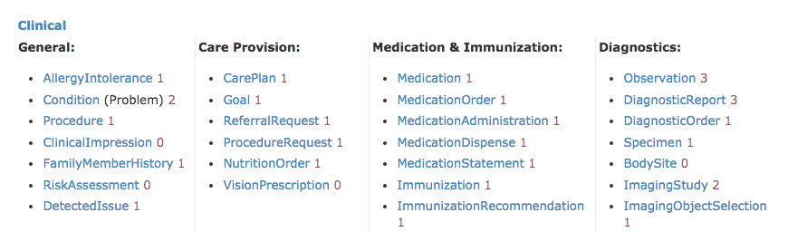

Resources

Slide 22
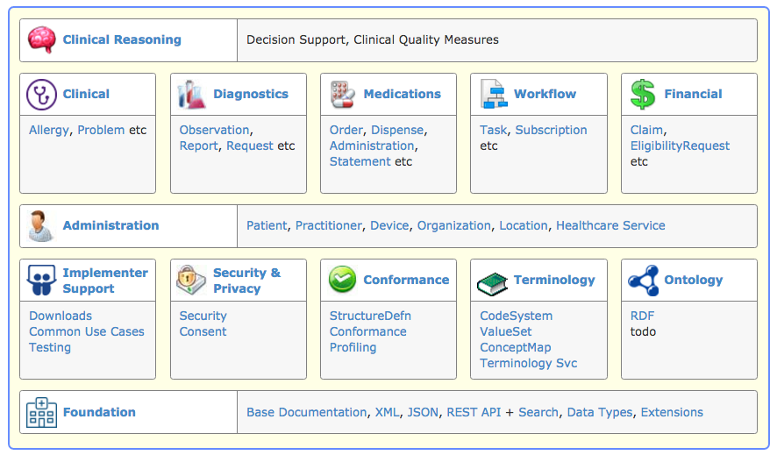
STU3 Sneak Peek: Modules

Slide 23

Structure of a Domain Resource
Metadata
Resource
Narrative
Elements
Extensions
Extensions

Slide 24
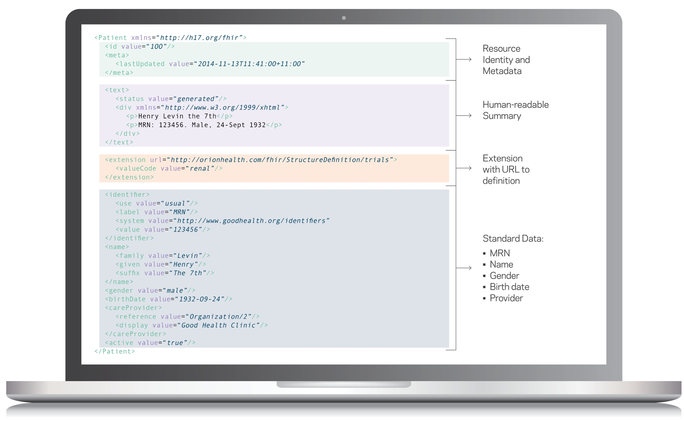
Resource Example

Slide 25
Composition versus reference
FHIR makes composition and references explicit:
References are between Resources. No context conduction across references – safe retrieval as individual resources.
Composition is within a Resource: Components have no meaning outside resource, no identity, no separate access path except through resource
Contained resources
Notes:
No context conduction: if a Condition resource references a particular Patient as it's subject, and it links to a Procedure resource as it's cause, there is no automatic rule or implication that the procedure has the same patient as it's subject.

Slide 26
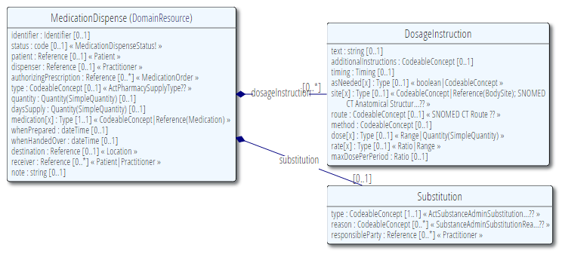
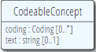
Components of a Resource
Resource Root
Resource Component
Simple & Complex elements (may be repeating)
Notes:
Medication Dispense – the Resource root
Dispense & Substitution are components within Medication Dispense
Use of non-primitive “datatypes” / “value types”
[RS] Black diamond signifies Composition – these don’t have a life outside of the associated class.

Slide 27
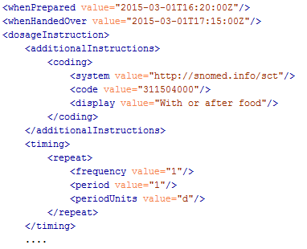
Composition
Notes:
Go into spec and look at element types – the hierarchy of elements – Domain Resource

Slide 28
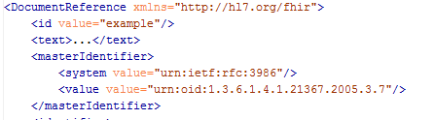
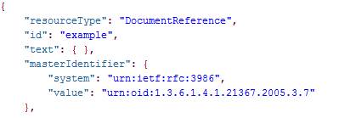
XML & JSON

Slide 29
References between resources
Coded Properties
type
bodySuite
indication
performer.role
complication
relatedItem.type
Other Properties
identifier (Identifier)
outcome (String)
PATIENT
Subject
CONDITION
RelatedItem
PROCEDURE
Report
DIAGNOSTIC REPORT
Encounter
Performer
ENCOUNTER
PRACTITIONER

Slide 30
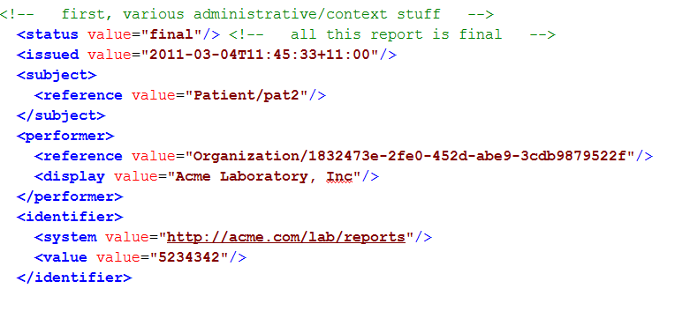
Resource Reference
Example: part of DiagnosticReport
Notes:
References between resources are not by “business key”, it is *not* the patient id, it’s a REST URI! [RS]

Slide 31
Recording a consultation
12-year-old-boy
First consultation
Complaining of pain in the right ear for 3 days with an elevated temperature. On examination, temperature 38°C and an inflamed right eardrum with no perforation. Diagnosis Otitis Media, and prescribed Amoxicillin 250mg 3 times per day for 7 days.
Follow up consultation
2 days later returned with an itchy skin rash. No breathing difficulties. On examination, urticarial rash on both arms. No evidence meningitis. Diagnosis of penicillin allergy. Antibiotics changes to Erythromycin 250mg 4 times per day for 10 days.
Patient
Encounter
Condition
Observation
Medication
Allergy Intolerance

Slide 32
Pain right ear 3 days
Asserter
Patient
Encounter
Elevated temperature
Performer
Temperature 38°C
Performer
Practitioner
Inflamed right drum
Performer
Otitis media
Asserter
Amoxicillin 250mg
Prescriber
Itchy skin rash
Asserter
Encounter
No breathing difficulties
Asserter
Urticarial Rash
Performer
Penicillin Allergy
Performer
Erythromycin 250mg
Performer

Slide 33
clinFHIR Demo
Mihin
Wendy Martinez McMahon

Slide 34
A Resource’s identity
In fact: an URL
http://server.org/fhir/Patient/1
resource type
endpoint
id
Note: This URL resolves to the current version of a resource
Notes:
This is not only the URL you use to retrieve the resource, it’s also its id.
All URL’s in FHIR are case-sensitive (and so is the id)
It is *metadata*, you won’t find this in the Resource’s definition

Slide 35
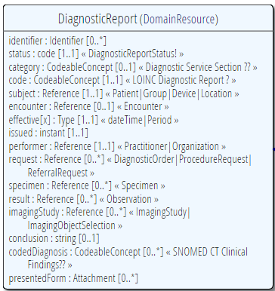
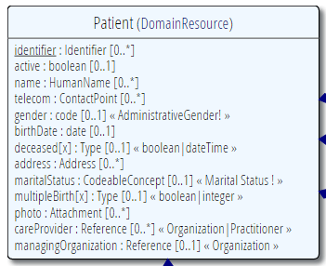
“Business” identifiers
Notes:
Resource Id’s (=URLs) are infrastructural id’s, they differ from “business” identifier.
Many Resources also have business identifiers, they are explicitly modeled, like Patient.identifier (even more than one identifier possible!)
Business identifiers are completely separate from technical resource id’s
The URL is the position of the resource and isn’t shown in the resource itself (metadata, see next slide) [RS]
Good to use words “Id” or “identifier” (even though those words are actually the same thing in most other contexts) [RS]

Slide 36
Resource metadata
Metadata
Patient
MRN 22234
“Ewout Kramer”
30-11-1972
Amsterdam
<id value="4705149-patient"/> <meta> <versionId value="4"/> <lastUpdated value="2016-08-10T16:18:46Z"/>
<profile value=… />
<security value=…/>
<tag value= …/> </meta>
…
Notes:
Pink box is resource
Metadata has the ID, and history with version of 4
(core resource and stuff around the resource – yellow is no longer in HTTP, but in metadata) - http://hl7.org/fhir/taghttp://example.org/fhir/Status#Test
In Bundle there are eTAGS

Slide 37
The FHIR Elements
Complex
Datatypes (HumanName, Quantity, Period, Address, Identifier )
Constrained Types (Quantity: Distance, Count, Duration, Money)
Metadata
Resource
Narrative
use
Elements
use
Extensions
Extensions
Primitives (integer, boolean,
string, instant)
use
Derived Primitives
(oid, uuid, code, id)
Notes:
[RS] changed composite to complex
[RS – resources are user definable?] Only the Resources are user-definable, other types are “built-in”
Derived primitives are patterns -> validation consists of regexp matching
Constrained types are defined using invariants (OCL, Xpath, prose) -> validation using schematron, code
[RS] Narrative and Extension are both ONLY used in Resources
Resources can use both (derived) primitives and complex composite datatypes in its definitions
[RS] Infrastructural types need special handling, not general-purpose types

Slide 38
Datatypes
Read more at:
http://www.hl7.org/implement/standards/fhir/datatypes.html
Notes:
Datatypes use both primitives and other datatypes.
Some datatypes use attributes with cardinality > 1
CodeableConcept.primary is actually refers to a coding in CodeableConcept.coding, so is not a code itself.
Quantity has constrained variations Distance, Count, Duration, Money. They introduce constraints on useable units, but do not add attributes, so not shown here.
Note that HumanId.assigner refers to a Resource

Slide 39
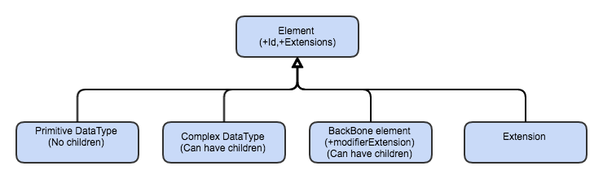
Element Hierarchy

Slide 40
Primitive data types
instant
time
date
dateTime
decimal
Element
boolean
integer
base64Binary
string
url
code
id
oid
unsignedInt
postiveInt
markdown

Slide 41
Details of some
boolean | xs:boolean | Values can be either true or false
integer | xs:int | A signed 32-bit integer
decimal | xs:decimal | A rational number. A true decimal, with inbuilt precision (e.g. Java BigDecimal)
base64Binary | xs:base64Binary | A stream of bytes, base64 encoded
instant | xs:dateTime | An instant in time - known at least to the second and always includes a timezone.
string | xs:string | A sequence of Unicode characters.
uri | xs:anyURI | A Uniform Resource Identifier Reference.
date | union of xs:date, xs:gYearMonth, xs:gYear | A date, or partial date as used in human communication. No time zone.
id | xs:string | Any combination of upper or lower case ASCII letters ('A'..'Z', and 'a'..'z', numerals ('0'..'9'), '-' and '.', with a length limit of 64 characters. regex: [A-Za-z0-9\-\.]{1,64}
Notes:
Now we will look at FHIR definitions from the bottom up, from datatype primitives, in several steps up to resources [RS]
The lexical rendering for these primitives in Xml is the same as in JSON (maybe this should go in the serialization section)
Expressing the allowed values in terms of XSD primitives brings in more variability then we would like. E.g. “0” and “1” are valid for xs:boolean. “+000004”, “4”, “+4” are all valid decimals.

Slide 42
Complex data types
Ratio
Period
Range
Attachment
Identifier
Timing
HumanName
Coding
Element
Annotation
Signature
Address
CodeableConcept
Quantity
SampledData
ContactPoint
Age
Distance
SimpleQuantity
Duration
Count
Money

Slide 43
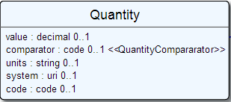
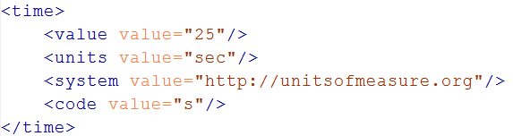
Example
Notes:
The content of a primitive is not rendered in XML as a text node but as an attribute
Notice how the “system” of a code is now a uri, so unlike in v3 an OID is now ALSO a uri (urn:oid:1.2.3.4.5)

Slide 44
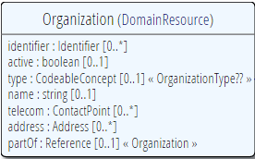
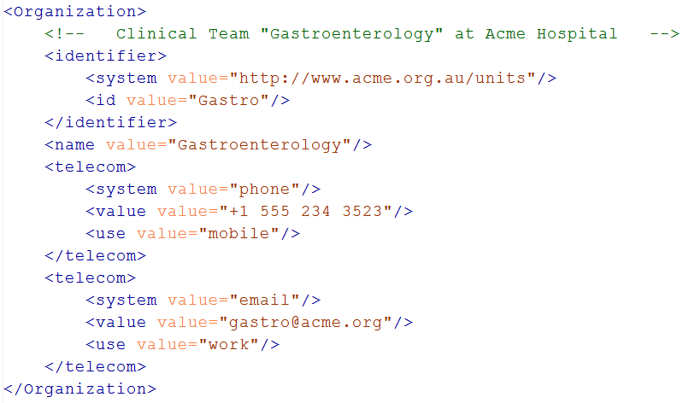
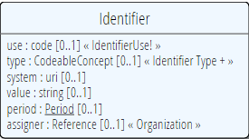
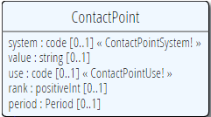
Resources
Notes:
The element “identifier” is of type Identifier
The element “telecom” repeats, there is no notion of a “list” in Xml.
Empty elements are left out
Rik – Both Identifier and Contact are datatypes, of identifier and telecom respectively
Rik – somewhat confusing that Organization.telecom has a type of Contact, and there is also a component class in Organization called Contact.

Slide 45
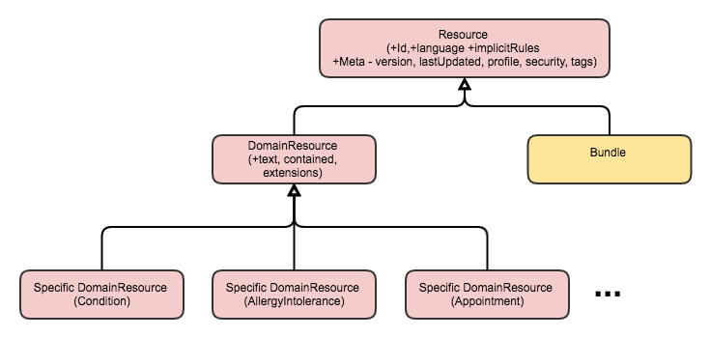
Resource Hierarchy
View in spec

Slide 46
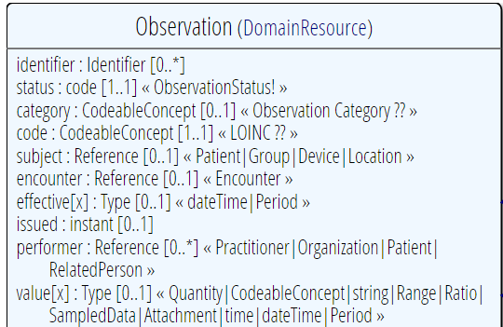
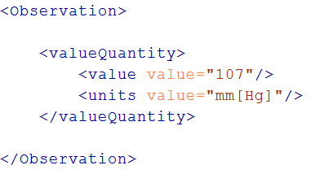
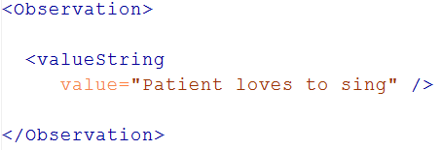
“Choice” properties
Notes:
* value[x] means: An element with a name that starts with “value”. The [x] is replaced by the (capitalized) name of the actual datatype

Slide 47
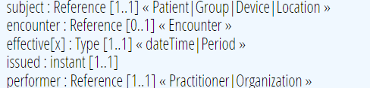
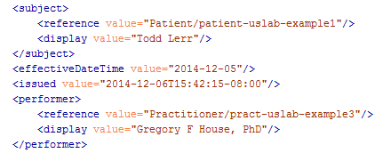
References
Notes:
There are references that can reference more than one type of resource! In this example: Resource(Patient | Group | Device)
The reference has a “type” element to indicate the kind of Resource that is referenced
References may be: Relative (on the same server), absolute URL (somewhere external) and internal (not treated here)

Slide 48
Quick look at narrative
Metadata
Resource
Narrative
Elements
Extensions
Extensions

Slide 49
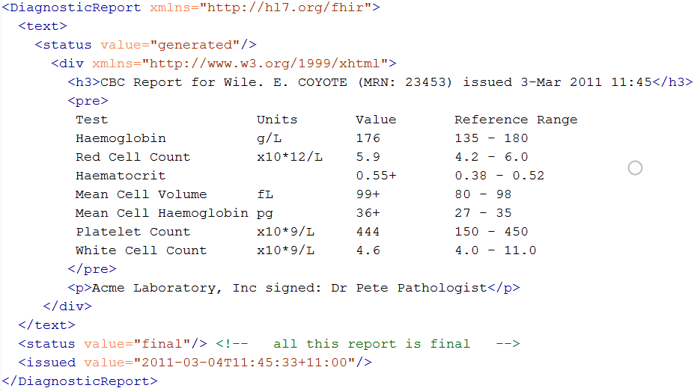
Narrative
Notes:
Resources SHOULD always contain narrative to support human-consumption as a fallback. However, in a strictly managed trading systems where all systems share a common data model and additional text is unnecessary or even a clinical safety risk, the narrative may be omitted.

Slide 50
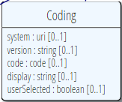
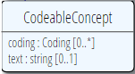
Coded types
code
Codes are defined in code systems
Notes:
CodeableConcept builds on Coding, which uses code [RS]
[Rik - This slide redone, CodeableConcept had extra attribute, also swapped the classes around. XML was using Problem which no longer exists]
Examples is from http://www.hl7.org/implement/standards/fhir/observation.htm
[RS] [removed bindings part, next slide]

Slide 51
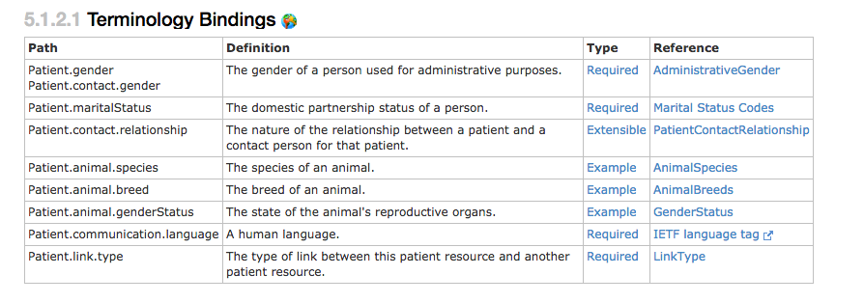
Coded types
When used in a Resource, the modelers include Bindings
Bindings specify which codes can be used
Notes:
Rik - Bindings are to value sets, as indicated by the “/vs/” in that path.

Slide 52
Binding Strength
How closely the options in the value set should be followed
Values
Required (must come from set)
Extensible (may use alternate if have to)
Preferred (don’t have to, but should)
Example (set isn’t specified)
Can vary in Profile
(Make stronger not weaker)

Slide 53
Examples
Code: "status" : "confirmed"
Coding: { "system": "http://www.nlm.nih.gov/research/umls/rxnorm", "code": "C3214954", "display": "cashew nut allergenic extract Injectable" }
CodeableConcept: { "coding": [{ "system": "http://snomed.info/sct", "code": "39579001", "display": "Anaphylactic reaction“ }], "text" : "Anaphylaxis" }

Slide 54
ValueSet resource
Defines list of possible values for a particular context
Can reference external Terminology/s
Or define own sets
Why?
A common valueSet improves recording consistency
Improves user experience (pick lists)
Examples in New Zealand
ED diagnoses (derived from SNOMED)
NZ POCS (Pathology Observation Code Set) (derived from LOINC)
List of NZ Iwi (defined in ValueSet)

Slide 55
Terminology Sub-system
Code System:
Defines a set of concepts with a coherent meaning Code Display
Definition
SNOMED CT / LOINC / RxNORM
HGVS, ICPC, MIMS + 100s more
ICD-X+
ANZSCO, METEOR
A drug formulary
A config table in an application
A list of enums in a java class
Australian state codes

Slide 56
Terminology Sub-system
Code System:
Defines a set of concepts with a coherent meaning Code Display
Definition
Value Set:
A selection of a set of codes for use in a particular context
Selects
Notes:
Eg condition with different specialties

Slide 57
Terminology Sub-system
Code System:
Defines a set of concepts with a coherent meaning Code Display
Definition
Value Set:
A selection of a set of codes for use in a particular context
Element Definition: Type and Value set reference
Binds
Selects

Slide 58
Terminology Sub-system
Code System:
Defines a set of concepts with a coherent meaning Code Display
Definition
Value Set:
A selection of a set of codes for use in a particular context
Element Definition: Type and Value set reference
Binds
Selects
Conforms
Element: code/ Coding/ CodeableConcept
Refers to

Slide 59
ValueSet for condition.code
{
"resourceType": "ValueSet",
"id": "valueset-condition-code",
"meta": {
"versionId": "1",
"lastUpdated": "2015-05-08T16:18:23Z",
},
"text": {
"status": "generated",
"div": ”Condition.code sample ValueSet"
},
"url": "http://hl7.org/fhir/vs/condition-code",
"version": "0.5.0",
"name": "Condition/Problem/Diagnosis Codes",
"publisher": "FHIR Project team",
"contact": [
{
"telecom": [
{
"system": "url",
"value": "http://hl7.org/fhir"
}
]
}
],
"description": "Example value set for Condition/Problem/Diagnosis codes",
"copyright": "This value set includes content from SNOMED CT, which is copyright © 2002+ International Health Terminology Standards Development Organisation (IHTSDO), and distributed by agreement between IHTSDO and HL7. Implementer use of SNOMED CT is not covered by this agreement",
"status": "draft",
"experimental": true,
"compose": {
"include": [
{
"system": "http://snomed.info/sct",
"filter": [
{
"property": "concept",
"op": "is-a",
"value": "404684003"
}
]
}
]
}
}

Slide 60




Terminology Server
Provides ‘services’ for consumers to access terminology
Hide the complex stuff from a consumer
Uses Operations framework
Get definition for a concept
Find a concept
Within a ValueSet
Find Terms
Get Term Definition
http://hl7.org/fhir/2015May/terminology-service.html
Notes:
Expand
http://fhir-dev.healthintersections.com.au/open/ValueSet/valueset-condition-code/$expand?filter=diabetes
Lookup
http://fhir-dev.healthintersections.com.au/open/ValueSet/$lookup?system=http://loinc.org&code=8480-6

Slide 61
Exercise: Build a Resource
clinFHIR
Resource builder (Condition)
Uses Terminology Server
Condition.code
Explore data set
Direct REST query from filter

Slide 62
resource misc.
Notes:
10:15

Slide 63
Tags
Contain metadata about resources
Beyond ID, version & date
Used for different purposes:
Compliance to Profile
Security – e.g. sensitivity of resource
User defined
Transported in different ways:
REST – as an HTTP header
In a bundle (document, message, transaction) - in the metadata element of the resource or the bundle

Slide 64
REST service interface
How FHIR uses RESTful principles to communicate Resources
Notes:
Time: 0:50:00-1:30:00 (40 minutes) [26 slides, 41 to 66]
Rik - start at 14:20

Slide 65
Paradigms
FHIR supports 4 interoperability paradigms
REST
Documents
Messages
Services
REST
Notes:
* Content is the same

Slide 66
REST?
“REpresentational State Transfer”
Represent your data as “resources”
Make “Resources” URI addressable
Use HTTP to do CRUD operations
Resources may be exchanged using different representations

Slide 67
Possibly distributed…
FHIR server @ pat.registry.org
FHIR server @ lab.hospitalA.org
Patient/223
DiagnosticReport/4445
Observation/3ff27
Patient
subject
Observation
Diagnostic
Report
result
managing
performer
FHIR server @ hospitalA.org
Organization/1
Practitioner/87
Organization
Practitioner
Notes:
Rik – Start at the top right with the report

Slide 68
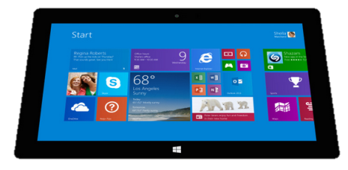

“Repository” model of healthcare
Hospital System
Lab System
Create
Update
Create
Update
Create
Update
Query
Query
Subscribe
FHIR server
Patient
Diagnostic
Report
Observation
Patient
Observation
Organization
Patient
Observation

Slide 69
Just a quick GET
GET /fhir/Patient/1 HTTP/1.1
HTTP/1.1 200 OK
Content-Type: application/xml+fhir;charset=utf-8
Content-Length: 787
Last-Modified: Tue, 29 May 2012 23:45:32 GMT
HTTP Verb + path
<?xml version="1.0" encoding="UTF-8"?>
<Patient xmlns="http://hl7.org/fhir"><identifier><label>SSN</label><identifier><system>
http://hl7.org/fhir/sid/usssn</system><id>444222222</id></identifier></identifier><name><use>official</use><family>Everywoman</family><given>Eve</given></name><telecom><system>phone</system><value>555-555 2003</value><use>work</use></telecom><gender><system>http://hl7.org/fhir/sid/v2-0001</system>
<code>F</code></gender><birthDate>1973-05-31</birthDate><address><use>home</use><line>2222 Home Street</line></address><text><status>generated</status><div xmlns="http://www.w3.org/1999/xhtml">Everywoman, Eve. SSN:444222222</div></text></Patient>
UTF-8 encoded
Version in resource
Notes:
You can retrieve any person using a GET on the person’s id, which is just an url on the server: /fhir/Patient/<id>
We have our own MIME-type: “text/xml+fhir”
Note that FHIR always uses UTF-8. Since this is not the default for HTTP, the server explicitly mentions this
But should mean the xml encoding mentions “utf-8” and that the payload is really encoded in utf-8
There can be a Byte Order Mark, but hopefully your framework handles all that ;-) [RS this is an optional character string preceding a UTF-8 set of bytes, to say if little endian or big endian – which is actually irrelevant to UTF-8]
The response returns a Content-Location header with a version-specific location….see next slide 52 [RS]
Specify XML / JSON
More on query later

Slide 70
A Resource’s REST identity
In fact: an URL
http://server.org/fhir/Patient/1
resource type
endpoint
id
Note: This URL resolves to the current version of a resource
Notes:
This is not only the URL you use to retrieve the resource, it’s also its id.
All URL’s in FHIR are case-sensitive (and so is the id)

Slide 71
Resource metadata
Metadata
Patient
MRN 22234
“Ewout Kramer”
30-11-1972
Amsterdam
<id value="4705149-patient"/> <meta> <versionId value="4"/> <lastUpdated value="2016-08-10T16:18:46Z"/>
<version value=“http://… /> <security value=…/>
<tag value= …/>
</meta>
…
Notes:
Pink box is resource
Metadata has the ID, and history with version of 4
(core resource and stuff around the resource – yellow is no longer in HTTP, but in metadata) - http://hl7.org/fhir/taghttp://example.org/fhir/Status#Test

Slide 72
Mapping (meta) data to HTTP
Resource data
Resource id
Resource version
Last update date
http body
Url
ETag
Last-Modified header
Notes:
Note that the Version Id is considered a "weak" ETag and ETag headers should be prefixed with W/ and enclosed in quotes, for example: ETag: W/"3141"

Slide 73
One more look at the header
POST /fhir/Patient HTTP/1.1
HTTP/1.1 200 OK
Content-Type: application/xml+fhir;charset=utf-8
Content-Length: 787
Location: http://fhir.furore.com/fhir/Patient/1/_history/12
Last-Modified: Tue, 29 May 2012 23:45:32 GMT
Notes:
You can retrieve any person using a GET on the person’s id, which is just an url on the server: /fhir/person/@<id>
We have our own MIME-type: “text/xml+fhir”
Note that FHIR always uses UTF-8. Since this is not the default for HTTP, the server explicitly mentions this
But should mean the xml encoding mentions “utf-8” and that the payload is really encoded in utf-8
There can be a Byte Order Mark, but hopefully your framework handles all that ;-)
The response returns a Content-Location header with a version-specific location….see next slide

Slide 74
For a specific version…
We have the version-specific URL
http://server.org/fhir/ (continued)
Patient/1/_history/4
base path
resource type
identifier
version id
Notes:
Both the Resource id URL and the version-specific URL are used on many places of the REST spec and resource content (References!). They are always used consistently in this form.

Slide 75
REST “representations”
GET /fhir/Patient/1?_format=json HTTP/1.1
HTTP/1.1 200 OK
Content-Type: application/json+fhir;charset=utf-8
Content-Length: 787
GET /fhir/Patient/1 HTTP/1.1
Accept: application/json+fhir
HTTP/1.1 200 OK
Content-Type: application/json+fhir;charset=utf-8
Content-Length: 787
Notes:
You can retrieve any patient using a GET on the patient’s id, which is just an url on the server: /fhir/Patient/<id>
We have our own MIME-type: “application/xml+fhir” and “application/json+fhir”

Slide 76
Mapping to verbs
create 2.1.10
The create interaction creates a new resource in a server assigned location. The create interaction is performed by an HTTP POST operation as shown:
POST [service-url]/[resourcetype] (?_format=mimeType)
read 2.1.6
The read interaction accesses the current contents of a resource. The interaction is performed by an HTTP GET operation as shown:
GET [service-url]/[resourcetype]/{id} (?_format=mimeType)
update 2.1.8
The update interaction creates a new current version for an existing resource or creates a new resource if no resource already exists for the given id. The update interaction is performed by an HTTP PUT operation as shown:
PUT [service-url]/[resourcetype]/{id} (?_format=mimeType)
delete 2.1.9
The delete interaction removes an existing resource. The interaction is performed by an HTTP DELETE operation as shown:
DELETE [service-url]/[resourcetype]/{id}
Notes:
Rik – these are section numbers from FHIR spec

Slide 77
To create a resource
You POST the contents to an url which indicates the resource type:
E.g. http://server.org/fhir/Patient
Supply body’s format in Content-Type header
Server returns 201 (Created).
Returns only the newly assigned version id URL in the Location header.

Slide 78
To update a resource
Use PUT on the resource’s URL, with the new contents in the body
Tell server the body’s format (xml/json) in the Content-Type header
Server returns 200 and the URL to new version in the Location header.

Slide 79
Using PUT to create
Server might/might not allow you to PUT to an id that does not yet exist.
If it does: Server returns 201 and resource gets created at that location ➔ client determines resource’s id!
If it does not: server returns 405 (Method not allowed)
Notes:
- Whether server allows this depends on the level of trust between server and client: e.g. in-house scenario versus nation-wide network.

Slide 80
Version-aware updates
Use eTag & ‘if-match’ header
Server requires client to send ‘if-match’ header with current eTag
Server uses this to check whether you are updating the latest version.
Server will then return 409 (Conflict) if it has been updated by someone else in the meantime
http://hl7.org/fhir/http.html#versionaware
Notes:
Behaviour depends on server configuration (and made public in a conformance statement).

Slide 81
Conditional operations
Eg create if not exist
Search query in ‘if-none-exist’ header
Especially useful in transactions, messages
Create / Update / Delete
http://hl7.org/fhir/http.html

Slide 82
What’s a ‘deleted’ Resource?
DELETE method
Trying read operations will return in a 410 (Gone) result instead of 404 (Not Found)
The resource will not be returned by the search operation
You can “undelete” by doing an update with fresh content
Just a “marker” in a resource’s history
Notes:
* the deletion operation should be understood as deleting the record of the resource, with nothing about the state of the real-world corresponding resource implied.

Slide 83
Version history - deletions
33, v12 – 2012-12-04
/server.org/fhir/Patient/33/_history/12
33, v13 – 2012-12-05
/server.org/fhir/Patient/33/_history/13
33, v14 – 2012-12-08
/server.org/fhir/Patient/33/_history/14
33, v15 – 2012-12-09
/server.org/fhir/Patient/33/_history/15
33, v16 – 2012-12-10
DELETION
/server.org/fhir/Patient/33/_history/16
/server.org/fhir/Patient/33
Notes:
* Now, if you query for /server.org/fhir/patient/33, you get a 410 [RS corrected note from @33, no longer using @]

Slide 84
Version history - revival
33, v13 – 2012-12-05
/server.org/fhir/Patient/33/_history/13
33, v14 – 2012-12-08
/server.org/fhir/Patient/33/_history/14
33, v15 – 2012-12-09
/server.org/fhir/Patient/33/_history/15
33, v16 – 2012-12-10
/server.org/fhir/Patient/33/_history/16
33, v17 – 2012-12-11
/server.org/fhir/Patient/33/_history/17
/server.org/fhir/Patient/33
Notes:
* The resource returns back to life!

Slide 85
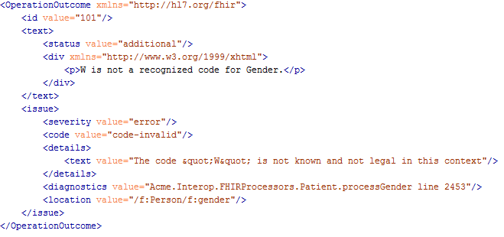
Operation Outcome
When something goes wrong….return the OperationOutcome Resource!

Slide 86
Lists of things
Current Allergies, Medications, Conditions
Use the List resource
Can query through _list
http://hl7.org/fhir/lifecycle.html#current
GET [base]/AllergyIntolerance?patient=42&_list=$current-allergies

Slide 87
The Binary Endpoint
Accepts any kind of content
Stores the content as is, along with the content type provided by the HTTP headers.
Acts just like the normal Resource endpoints (but there is no search)
http://server.org/fhir/Binary/

Slide 88
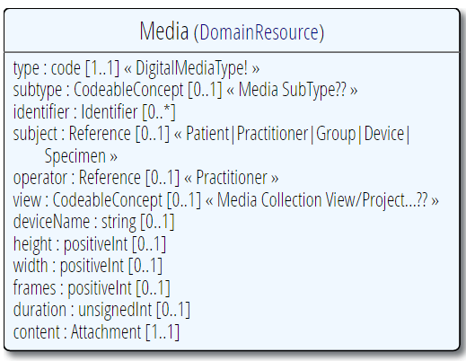
Useful for Attachments
/Binary/23344

Slide 89
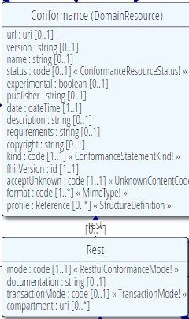
Conformance
Which FHIR version?
Which Resources?
What search operations?
What formats?
Is this a test server?
Who can I contact?
What’s the name of the software?
DO YOU SUPPORT HISTORY?
DO YOU SUPPORT XML/JSON?
http://www.hl7.org/fhir/conformance.htm

Slide 90
Resources in code
How resources are made into classes in the supplied reference implementations
Notes:
Time: 40:00-50:00 (10 minutes) [7 slides, 67 to 73]
Rik - should start at 14:50, with break at 15:00

Slide 91
Reference implementations
Contents
Model – classes generated from the spec
Parsers – Parsers generated from the spec
Serializers – Serializers generated from the spec
FhirClient
Validation (currently Java only)
Java – Everything on the downloads page
HAPI library - http://jamesagnew.github.io/hapi-fhir/
.NET – NuGet “FHIR”, or GitHub “fhir-net-api”
Notes:
[RS]
NuGet syntax: Install-Package Hl7.Fhir –Pre
http://ewoutkramer.github.io/fhir-net-api/whats-new.html

Slide 92
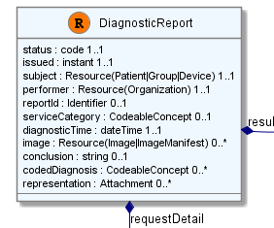
Object Model
[FhirResource("DiagnosticReport")]
public partial class DiagnosticReport : Resource
{
public Code<ObservationStatus> Status {…}
public Instant Issued {…}
public ResourceReference Subject {…}
public ResourceReference Performer {…}
public Identifier ReportId {… }
public
List<DiagnosticReportRequestDetailComponent> RequestDetail { …}

Slide 93
Parsing/Serializing using C#
// Create a file-based reader for Xml
XmlReader xr = XmlReader.Create(
new StreamReader(@"publish\observation-example.xml"));
// Parse the Observation from the stream
var obs = (Observation)FhirParser.ParseResource(xr);
// Modify some fields of the observation
obs.Status = Observation.ObservationStatus.Amended;
obs.Value = new Quantity() { Value = 40, Units = "g" };
// Serialize the in-memory observation to Json
var jsonText = FhirSerializer.SerializeResourceToJson(obs);

Slide 94
Parsing/Serializing using Java
XmlParser xml = new XmlParser();
Observation obs = (Observation)xml.parse(new FileInputStream(“observation.xml"));
obs.setStatusSimple(ObservationStatus.amended);
Quantity newValue = new Quantity();
newValue.setValueSimple(new BigDecimal(40)); newValue.setUnitsSimple("g");
obs.setValue( newValue );
ByteArrayOutputStream bos = new ByteArrayOutputStream();
JsonComposer comp = new JsonComposer();
comp.compose(bos, obs, true);
String json = bos.toString("UTF8");

Slide 95
Using FHIR Client in C#
var client = new FhirClient(
new Uri("http://fhir.com/svc/fhir"));
var patEntry = client.Read<Patient>("1");
var pat = patEntry.Resource;
var restId = patEntry.Id;
var tags = patEntry.Tags;
pat.Name.Add(HumanName.ForFamily("Kramer")
.WithGiven("Ewout"));
client.Update<Patient>(patEntry);

Slide 96
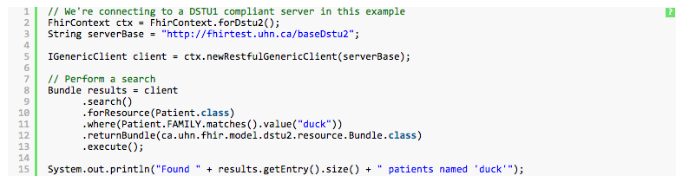
Using FHIR Client in Java
http://jamesagnew.github.io/hapi-fhir/doc_rest_client.html

Slide 97
BUNDLES
Notes:
Time: 0:50:00-1:30:00 (40 minutes, 16 slides 74 to 89)
Rik - Start after break at 15:30

Slide 98
Communicating lists
We need to communicate lists of Resources
Search result
History
Documents or messages
Multiple-resource inserts (batches or transactions)
Descend from Resource (not DomainResource)
No text, extensions, contained

Slide 99
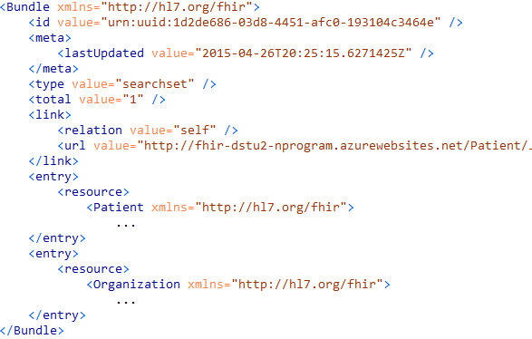
Query response

Slide 100
Example: Keeping in sync
History of all resources on server
http://server.org/fhir/_history
History of all patient resources on server
http://server.org/fhir/Patient/_history
History of specific patient on server
http://server.org/fhir/Patient/1/_history
A history of all changes: updates and deletions, ordered by newest first
Limit with _since and _count
Notes:
[RS _since is used with _history]

Slide 101
Transactions / Batches
Multiple operations at once
Transaction
Related resources - Referential integrity
Batch
Unrelated
Return bundle with outcomes

Slide 102
Bundles in a Library
C# hides the processing of bundle
Bundle result = new Bundle() { Title = "Demo bundle" };
result.Entries.Add(new ResourceEntry<Patient>()
{ LastUpdated=DateTimeOffset.Now, Content = new Patient() });
result.Entries.Add(new DeletedEntry()
{ Id = new Uri("http://..."), When = DateTime.Now });
var bundleXml = FhirSerializer.SerializeBundleToXml(result);

Slide 103
SEARCH FUNCTIONALITY
And finally, the last REST operation (for now):
Notes:
Time: 1:30:00-1:50:00 (20 minutes) [9 slides, 90 to 98]
Rik – Start at 16:05

Slide 104
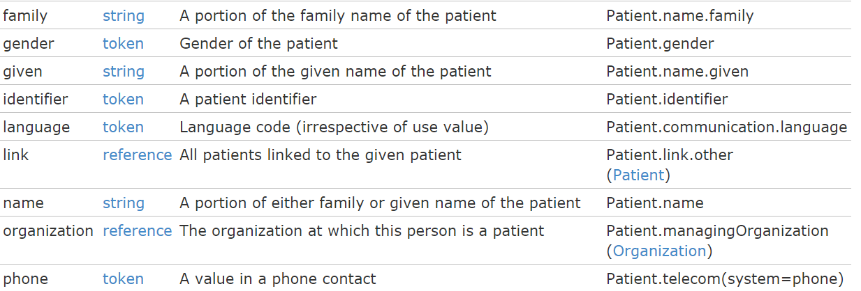
Search (patient)
Each resource has a set of “standard” search operations, so not every element can be searched!:

Slide 105
Combining parameters
Can search by GET & POST
Always return a bundle
Multiple parameters
Specifying multiple parameters finds resources matching all params ➔ “AND”
http://fhirtest.uhn.ca/baseDstu3/Patient?name=jones&gender=female
Parameters may list multiple values ➔ “OR”
http://fhirtest.uhn.ca/baseDstu3/Patient?name=patel,jones

Slide 106
Ok I get it…or not?
http://server.org/fhir/Patient/ 406 hits
http://server.org/fhir/Patient?gender=M 234 hits
http://server.org/fhir/Patient?gender=F 167 hits
Total: 234 + 167 = 401
http://server.org/fhir/Patient/ 406 hits
http://server.org/fhir/Patient?gender=M 234 hits
http://server.org/fhir/Patient?gender=F 167 hits
http://server.org/fhir/Patient?gender:missing=true 5 hits
Total: 234 + 167 + 5 = 406
Notes:
[RS] key here is that some are neither M nor F
[RS] Look at For more info see modifiers on the HL7 FHIR site (:exact, :missing, etc.) Search, 2.2.2.1

Slide 107
Combining parameters
Specifying multiple parameters finds resources matching all params ➔ “AND”
Parameters may list multiple values ➔ “OR”
http://server.org/fhir /Patient/search?
birthdate=1972-11-30
&language=NL,FR

Slide 108
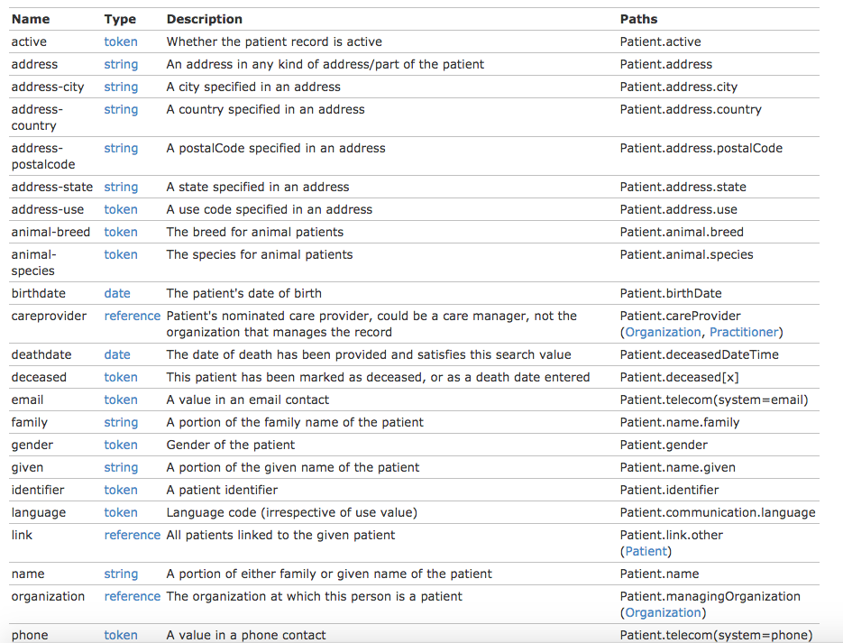
Example: Patient

Slide 109
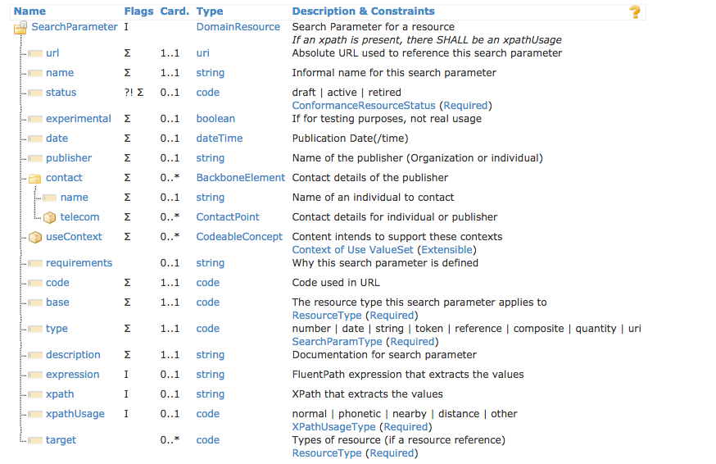
SearchParameter resource

Slide 110
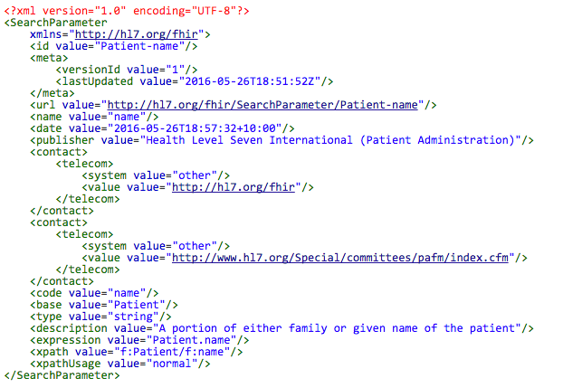
SearchParameter example
http://fhir3.healthintersections.com.au/open/SearchParameter/Patient-Name

Slide 111
Search (Patient)
Each search parameter has a ‘type’
Parameter
Type

Slide 112
Chained searches
Patient has a search for “name”.
Observation has a search for “subject” (the id of the Patient, Group or Device)
How do I find Observations for a patient, searching using his name?

Slide 113
2 queries in 1
You (as a client) don’t need to do separate operations, just one:
http://server.com/fhir/Observation?patient .name=jones
But note: this still only works on the predefined search parameters. You cannot just use any property of the resource.

Slide 114
More optimizations
Say we do:
http://fhir.com/fhir/Observation?date=2014-01-20
We get back: a Bundle with 0..* “Observations”
Now, usually, wouldn’t we want the Patient information too? => Need to do “N” queries for the Observation’s “subject”
Quicker:
?_include=Observation:patient
Returns both Observations + Patients
Search Param
Notes:
http://fhirtest.uhn.ca/baseDstu2/Observation?date=2016-10-13&_include=Observation:patient

Slide 115
Advanced search
Common Parameters
_id
_lastUpdated
_tag
_profile
_security
_text
_content
_list
_query
Search Result Parameters
sort
count
include
revinclude
summary
elements
contained
containedType

Slide 116
Common parameters - I
_id
Query by Id (string)
_lastUpdated
When the resource was last updated (date)
_tag
From the appropriate meta element (token)
_profile
From the appropriate meta element (url)
_security
From the appropriate meta element (token)

Slide 117
Common parameters - II
_text
Search in text element (string)
_content
Search for text across the entire resource (string)
_list
Return resources referenced by a List resource
Can use ‘current lists’ and other query
http://hl7.org/fhir/lifecycle.html#current
_query
Custom named query
Use OperationDefinition to define

Slide 118
Search Result Parameters - I
_sort
The order of returned results (format changing in STU-3)
_count
Specify a number of resources to include
_include
Include other resources (more detail soon)
_revinclude
Include resources that reference this one
Eg provenance

Slide 119
Search Result Parameters - II
_summary
Return a subset
true, false, text, data, count
Resources marked as ‘SUBSETTED’
_elements
Specify elements to return (+mandatory)
Resources marked as ‘SUBSETTED’
_contained
Whether search should include contained resources
False (default), true, both
_containedType
With _contained – whether to return the container

Slide 120
Chained searches
Search based on referenced properties
Observation has a search for “subject” (the id of the Patient, Group or Device)
Patient has a search for “name” and “identifier”.
‘chained’ search:
[host]/Observation?subject.name={x}
[host]/Observation?subject.identifier={y}
But note: this still only works on the predefined search parameters. You cannot just use any property of the resource.
http://fhirtest.uhn.ca/baseDstu3/Observation?subject.name=patel

Slide 121
_Include related resources
Include related resources in the response
Based on search parameters
Server declares in conformance
Format
[host]/{type}?_include={source type}:{search parameter}:{target type}
Eg
[host]/MedicationOrder?_include=MedicationOrder:patient&criteria...
http://fhirtest.uhn.ca/baseDstu3/Observation?_id=99267&_include=Observation:encounter
http://fhirtest.uhn.ca/baseDstu3/Observation?subject.name=patel&_include=Observation:patient

Slide 122
Compartment
Syntactic sugar for queries
Resources that share common property
Eg patient
Purpose:
Access mechanism for finding a set of related resources quickly
Provide a definitional basis for applying access control to resources quickly
http://hl7.org/fhir/compartments.html

Slide 123
Getting “all” patients
http://server.org/fhir/Patient
Usually returns a paged feed
Use _count to indicate number of results per page
Special case of the “real” search operation: http://server.org/fhir/Patient/_search?name=eve http://server.org/fhir/Patient?name=eve
Notes:
[RS] _search version is an alternative, and is documented in 2.1.11, under RESTful API
[RS] note search is case and accent insensitive (unless :exact is specified), and are “partial”. 2.2.2.4

Slide 124
Beyond REST
How FHIR supports messages and documents
Notes:
Time: 1:50:00-2:00:00 (10 minutes) [18 slides, 99 to 116]
Rik - Start 16:25

Slide 125
Paradigms
FHIR supports 4 interoperability paradigms
REST
Documents
Messages
Services

Slide 126
Regardless of paradigm
the content is the same
Receive a lab result in a message…
FHIR
Repository
FHIR Message
FHIR Document
Lab System
REST
National
Exchange
…Package it in a discharge summary document

Slide 127
Documents

Slide 128
Documents – are bundles
Composition Resource
<Bundle>
<entry>
<Composition />
</entry>
<entry>
<Observation />
</entry>
<entry>
<Device />
</entry>
<entry>
<List/>
</entry>
<entry>
<Condition/>
</entry>
</Bundle>
Metadata
Attester
Section
Section
Section
Observation Resource
Device Resource
List Resource
Condition Resource
Notes:
A Document, no matter how nested, is flattened to a list of entries, the Document’s header being the first.
The document header (and any other the other resources) refer to each other using normal references to reflect the document’s nesting.
Of course, there may be a digital signature (on the whole Bundle) to attest to the content of the document.

Slide 129
FHIR Document
Discharge
Summary Composition
Dr. Bernard Practitioner
Patient Mary Patient
author
subject
Kidney Stones Condition
Chief Complaint section
entry
Pulse Observation
Vital Signs list
entry
Physical section
BP Observation
entry
Medications section
Discharge Meds list
Dyclofenac MedicationOrder
entry
entry
Tamsulosin MedicationOrder

Slide 130
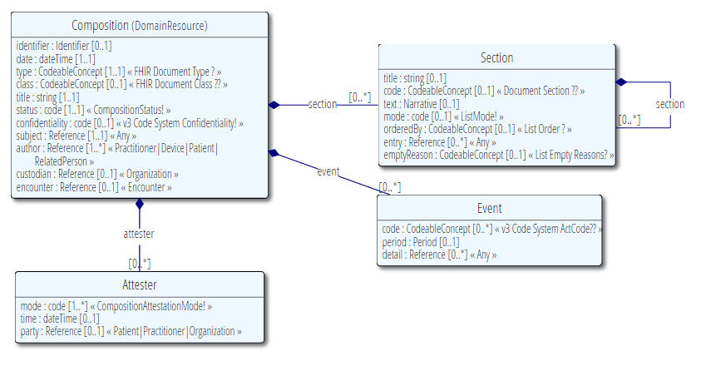
The Composition resource

Slide 131
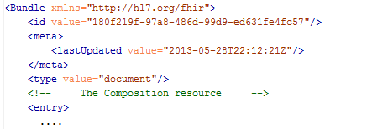
Bundle as “Document”
This Bundle is a Document
Notes:
[RS] Tags are http header “category”s

Slide 132
Communicating documents
You can store your document using
http://server.org/fhir/Composition
Others discussed in spec
Storage, NO disassembly is implied, document (and signature) stays intact
Search is supported (you search on it’s Message header – Composition)
Notes:
* But of course, some server could have functions to disassemble documents on reception. Since the contents of documents are resources, each of the contained resources (including the Document header) can be stored using the normal REST interface. But they are no longer the document anymore!

Slide 133
In the spec:
http://hl7.org/fhir/documents.html

Slide 134
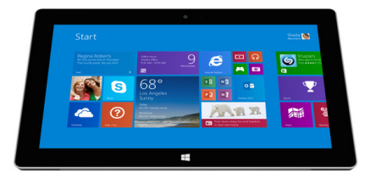
CDA and FHIR
CDA to FHIR Document bridge
FHIR Document processor
FHIR
Repository
FHIR
Documents
V3 CDA Documents
FHIR
REST
Hospital System A
Note: Documents are compositions,
No update semantics
Context?
Wholeness?

Slide 135
messages

Slide 136
Messages – are bundles
<Bundle>
<entry>
<MessageHeader />
</entry>
<entry>
<Observation />
</entry>
<entry>
<Patient />
</entry>
<entry>
<Device />
</entry>
</Bundle>
MessageHeader Resource
source
destination
event
Observation Resource
Device Resource
Patient Resource
Notes:
A Message is similar, refers (amongst others) to its author, and contains information about the source, destination and the event that triggered it.
A message contains 1 “data” resource, which is the root of the payload of the message. This is just a normal resource, which in its turn can refer to other related resources.

Slide 137
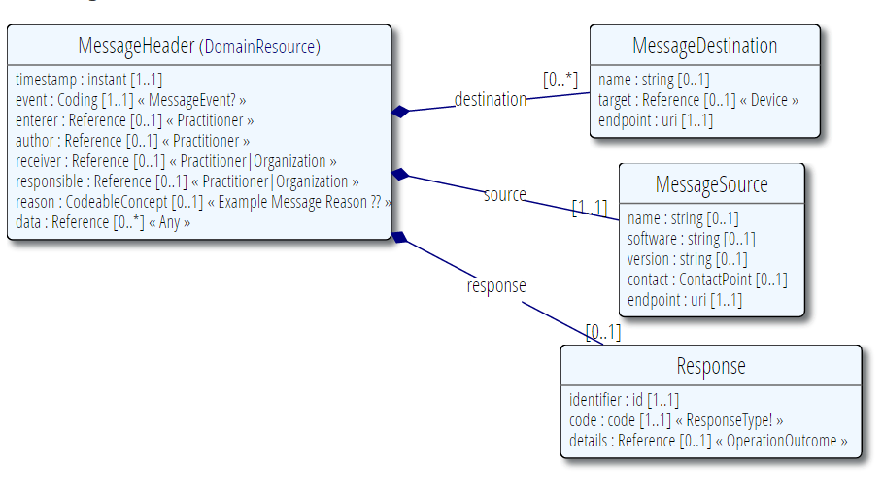
MessageHeader Resource

Slide 138
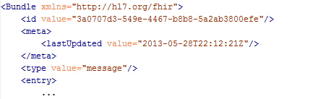
Bundle as “Message”
This Bundle is a Message

Slide 139
Sending messages
Again, REST not necessary, but…
There is an explicit REST operation:
[base]/$process-message
No storage implied. Might be a router, converted to v2, etc. etc.
The server can process them based on the event code and return the response as another message (again a bundle).
Notes:
* It’s the same drop-off point as for documents!

Slide 140
Resource identity
Often use GUID and ID and conditional Create

Slide 141
V2 and FHIR
V2 to FHIR bridge
FHIR Message processor
FHIR
Repository
FHIR
Messages
V2 Messages
FHIR
REST
Hospital System
Note: Messages are events,
REST exposes a “repository”
Model of data…

Slide 142
In the spec:
http://hl7.org/fhir/messaging.html

Slide 143
operations

Slide 144
FHIR Operations
When more complex server logic required than simple CRUD
Midway between REST & SOAP
Some defined in spec. e.g.:
Get all data for a patient
Expand/filter terminology
Can define custom services
Still using FHIR resources
Resources to define / inputs

Slide 145
Operations demo
View in Spec
Examples
$validate
$expand
$everything
http://fhirtest.uhn.ca/baseDstu3/ValueSet/condition-code/$expand?filter=asthma

Slide 146
SOA
Using FHIR resources with SOA patterns
More complex environments
In the spec: http://hl7.org/fhir/services.html

Slide 147
Profiles and validation
Short introduction to
Notes:
Time: 40:00-50:00 (10 minutes) [9 slides, 126 to 134]
Rik – 16:45

Slide 148
Profiling
The basic resources are not enough
Many different contexts in healthcare
Specific implementations / Use Cases need to:
Extend resources
Constrain resources
Specify code sets / terminologies
Specify resources used
Multiple supporting artifacts in FHIR
‘Conformance’ resources
FHIR is a platform specification
Profiles adapt it to specific purposes
Doesn’t change wire format
Discoverability / Manage expectations
Profiling increasingly important
Allows clinicians to express reqirements
Tooling supports Clinicians and Analysts involvement
Whole spec build on profiling infrastructure
Notes:
Eat your own dog food

Slide 149
Claiming conformance
Profiles are like a template
Servers indicate what profiles they support
Clients can interrogate servers
Conformance resource lists supported profiles
http://107.170.196.80/resourceCreator.html?conformance=ohConformance&hideNav
Resource instances ‘claim conformance’ to 1 or more profiles
Libraries developed to test this
Can be conformant without claiming
Cannot set defaults
Can state what a value should be

Slide 150
Extensions
Only most common elements in base resource
Keeps the resources small
(Adding everything was the problem with version 3)
Extensions allow other elements to be defined
Same capabilities as core elements
Including resource references and terminology bindings
Can extend properties and datatypes as well as the resource
Extensions are normal
Expect all real implementations to use extensions
‘normal’ and modifierExtensions
Normal extensions can be ignored by a recipient
Unknown modifierExtensions cannot be ignored

Slide 151
Quick look at extensions
Metadata
Resource
Narrative
Elements
Extensions
Extensions
Notes:
[RS think these notes are copied from slide 20]
Only the Resources are user-definable, other types are “built-in”
Derived primitives are patterns -> validation consists of regexp matching
Constrained types are defined using invariants (OCL, Xpath, prose) -> validation using schematron, code
Narrative and Extension are both ONLY used in Resources
Resources can use both (derived) primitives and composite datatypes in its definitions
Infrastructural types need special handling, not general-purpose types

Slide 152
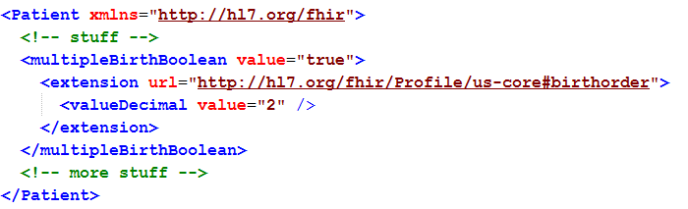
Extending a multiple birth
Key = location of formal definition
Value = value according to definition
Notes:
Really any FHIR element (Resource, Datatype, Primitive) can be extended. Just nest an <extension> element under the thing you want to extend
You should be able to go to the formal definition endpoint and get the definition of the extension.
Note: birth order is already provided for in FHIR through the multipleBirthInteger

Slide 153
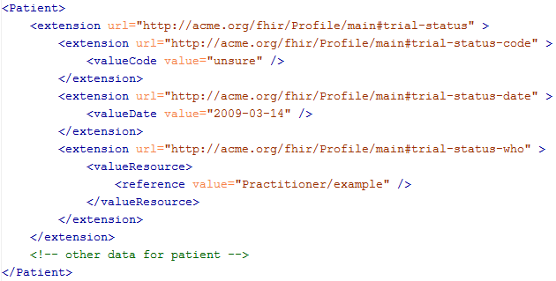
Complex extensions

Slide 154
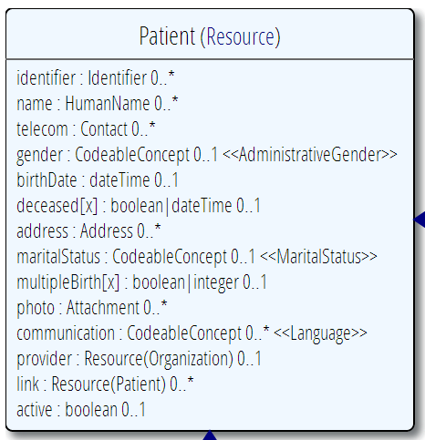
Profiling a resource
Specify that the identifier uses the NHI – and is required
Limit names to just 1 (instead of 0..*)
Limit maritalStatus to different set of codes (ValueSet)
Multiple Birth indicator only boolean
Indicate photo not supported
Add an extension to support “Ethnicity”
Note: hardly any mandatory elements in the core spec!

Slide 155
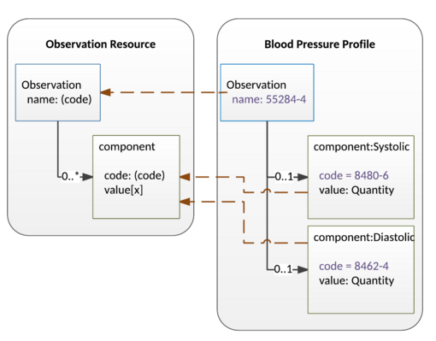
Slicing
Specifying repeating elements
Eg Blood Pressure (Observation.component)
Composition (document sections)
Constraining datatypes
Eg MedicationDispense.medication

Slide 156
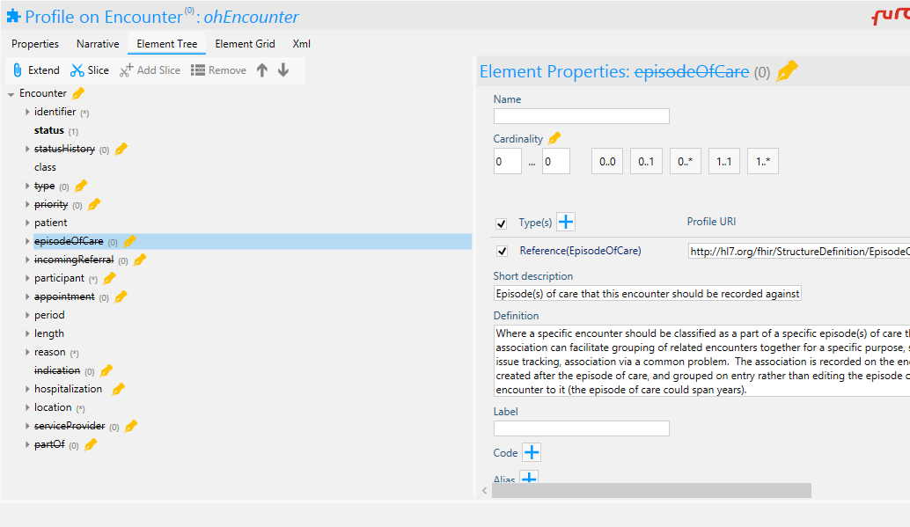
Forge

Slide 157
‘Conformance’ resources
StructureDefinition
The resource that ‘defines’ a resource
core and ‘profiled’
also used for extensions
describes binding to ValueSets
ValueSet
Options for coded elements
NamingSystem
Defines system

Slide 158
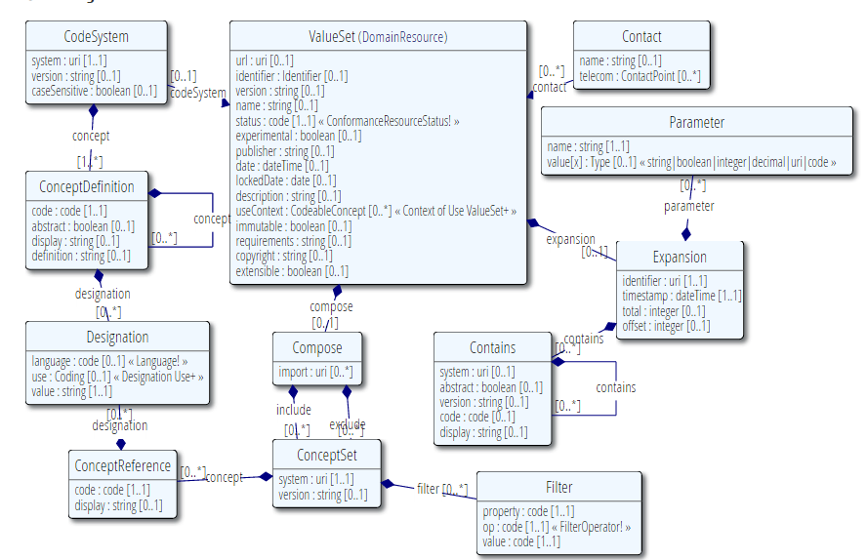
Value Set
Publication meta-data
Concepts from 1 or more existing systems
Additional concepts

Slide 159

References
URI vs URL
Canonical URL

Slide 160
A profiled resource Instance
{
"resourceType": "AllergyIntolerance",
"meta": {
"profile": [
"http://fhir.hl7.org.nz/dstu2/StructureDefinition/ohAllergyIntolerance"
]
},
"extension": [
{
"url": http://fhir.hl7.org.nz/dstu2/StructureDefinition/al-certainty”,
"valueCodeableConcept": {
"text": "really sure"
}
}
],
"patient": {
"reference": "Patient/14317",
"display": "Eve E. Everywoman "
}
}

Slide 161
Validating a claim
It’s only a claim…
Tooling (java) that can check
One resource can be conformant to multiple profiles
For design, use $validate operation
http://hl7.org/fhir/resource-operations.html#validate
Or use XML schema / schematron
Or java validator

Slide 162

(Distributed) validation
App’s server
Profile X
Profile Y
Store &
Validate
Country validation server
Profile X
Validate Y
Profile Y
Download & Validate
Profile Y
Notes:
A server might defer validation to another server (because it doesn’t know the profile)
A server may fetch the “unknown” profile and validate it itself
There may be several servers sharing the work

Slide 163

Implementation Guide: Data Access Framework
http://hl7.org/fhir/daf/daf.html
Notes:
Show in spec

Slide 164
Viewing Profiles: clinFHIR
Select Profile
Look at structure
Build resource
clinfhir.com

Slide 165
Moving on…
Notes:
Time: 1:30:00-1:50:00 (20 minutes) [9 slides, 90 to 98]
Rik – Start at 16:05

Slide 166
STU-3
Modules
Updated and new resources
Decision Support
CQF
Implementation Guides
Workflow
https://onfhir.hl7.org/2016/08/24/fhir-stu3-ballot-documentation/

Slide 167
Extending FHIR
FluentPath
https://github.com/ewoutkramer/fhirpath
FHIR Mapping Language
http://hl7.org/fhir/2016May/mapping-language.html
CDS Hooks

Slide 168

SMART

Slide 169
exposing a fhir service
FHIR in practice
Notes:
Time: 2:35:00-2:55:00 (20 minutes)

Slide 170
Process for Organizations exposing resources
Design / Gap analysis between internal data stores & FHIR
Outcome = resources, extensions & constraints
Find / build extensions & publish
Which registries?
URI vs URL
Build & publish profile
Update Conformance resource
Including operations
Use clinFHIR for samples

Slide 171
Some thoughts
Study the spec
Much more than resource lsist
Use a library
Expose a Conformance resource
Create profiles
Utilize testing resources
http://www.aegis.net/touchstone.html
Come to a Connectathon
Join the community

Slide 172
Adding profile claims to resources
Technically easy
Meta.profile[]
Can the server decide?
Or must resource claim – should server validate
If server, then at Read or Write time?
What to do with resources containing data we don’t store
What about non-conformant data?
Eg have observation in different terminology
?Client responsibility

Slide 173

Implementer Checklist
http://hl7.org/fhir/Implementation.html#2.0.0.1

Slide 174
Specifier to Developer
What’s the Interface?
Implementation guide
Conformance resource
Profiles
Extension Definitions
ValueSets
Other ‘conformance’ resources

Slide 175
Security
FHIR is not a security standard
Leverages existing standards
SMART (OAuth2)
Security tags
Specialized resources
Provenance, AuditEvent
http://hl7.org/fhir/security.html

Slide 176
The end is near…
Notes:
Time: 10:00-35:00 (25 minutes)

Slide 177
Balloting plans
Second Draft Standard for Trial Use ballot (DSTU) complete
FHIR is now published as a DSTU
Now STU
Will provide a semi-stable platform for implementers while still allowing non-backward-compatible change for Normative version if implementation experience dictates
Additional STU versions every 1.5-2 years to make fixes, introduce new resources
Resource maturity
Normative is around 2 years out
We want *lots* of implementation experience before committing to backward compatibility

Slide 178
More information/help
http://www.hl7.org/implement/standards/fhir/
http://www.fhir.org/
https://chat.fhir.org/
http://wiki.hl7.org/index.php?title=FHIR
http://www.healthintersections.com.au/
https://fhirblog.com/
https://thefhirplace.com/

Slide 179

Next Steps for you
Read the spec: http://hl7.org/fhir
Try implementing it
Furore Devdays
http://fhir.furore.com/devdays
Come to a Connectathon!
Join the community
https://chat.fhir.org
fhir@lists.hl7.org
Twitter #FHIR
StackOverflow: hl7 fhir tag
Blogs & wiki: http://wiki.hl7.org/index.php?title=FHIR

Slide 180
Thank You - QUESTIONS?
Notes:
[RS – added thank you]

